Slide 1
Inferential Statistics

Slide 2
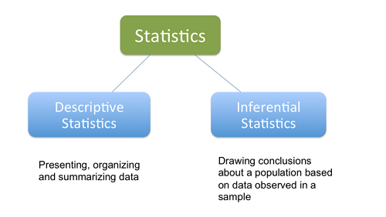

Slide 3
Inferential statistics use a
random sample of data taken
from a population
to describe and
make inferences about the population.

Slide 4
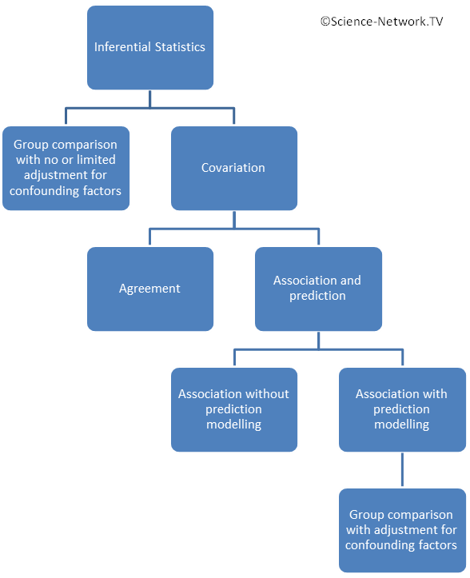

Slide 5
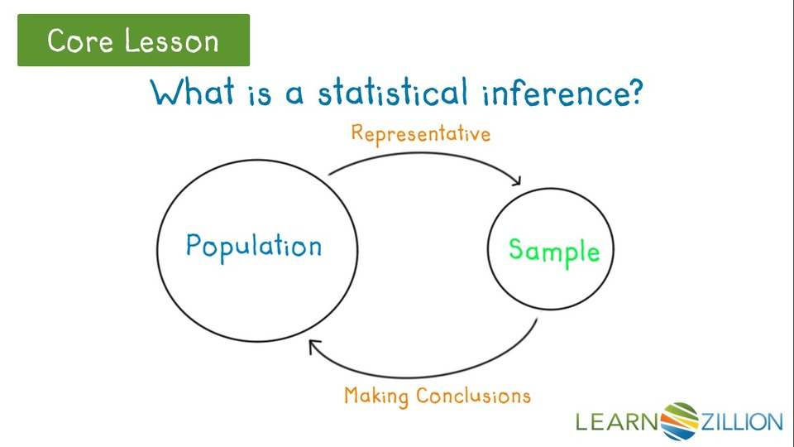

Slide 6
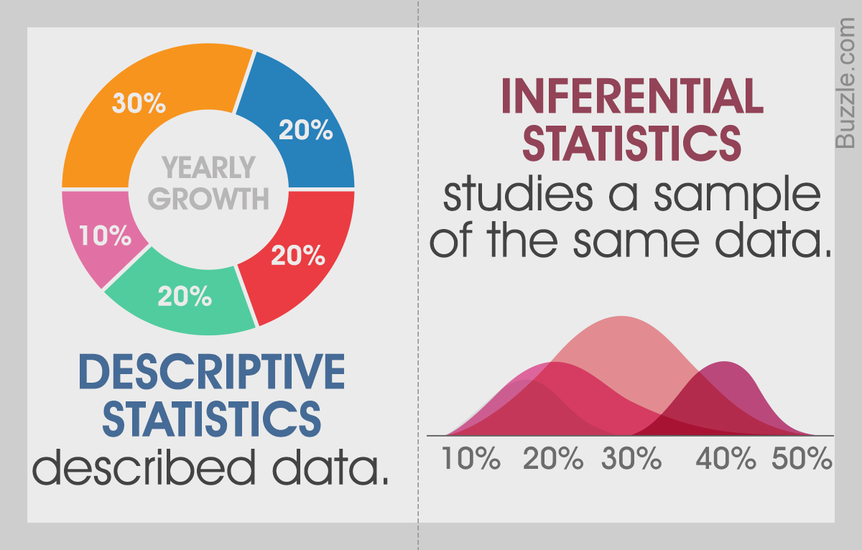

Slide 7
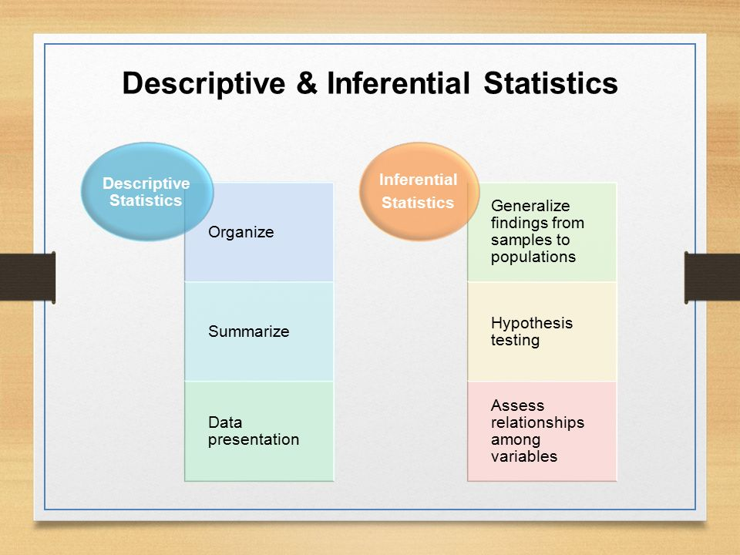

Slide 8
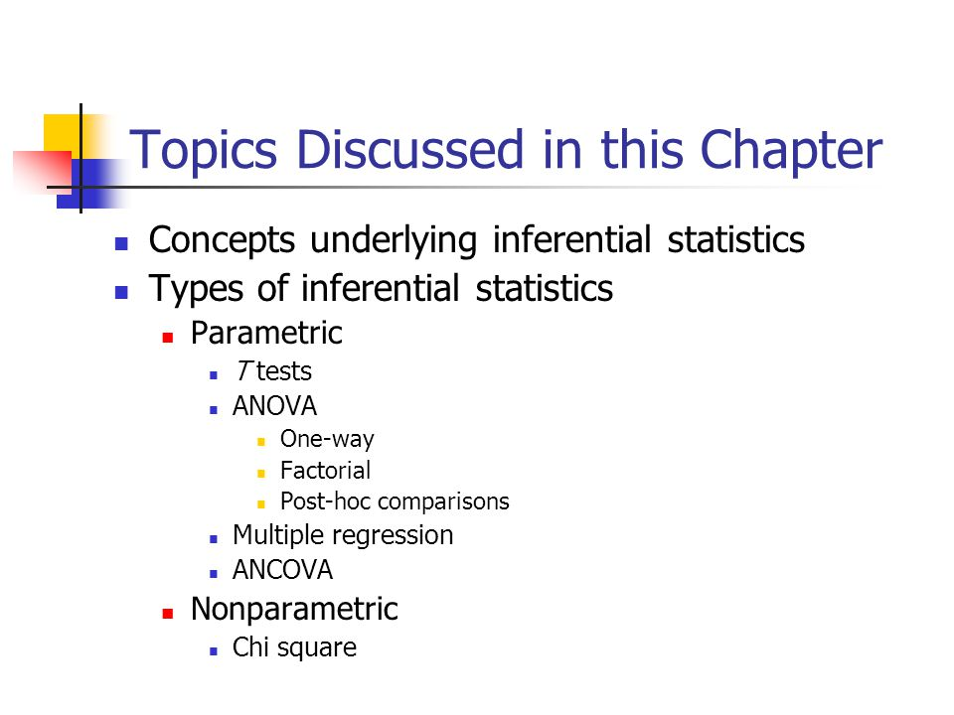

Slide 9
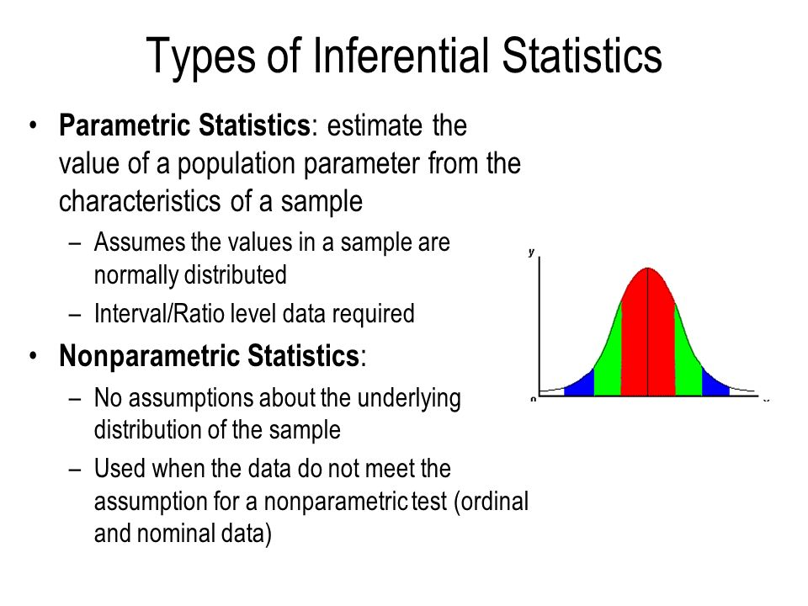

Slide 10
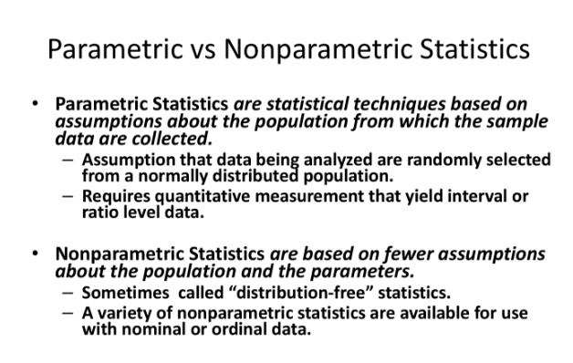

Slide 11
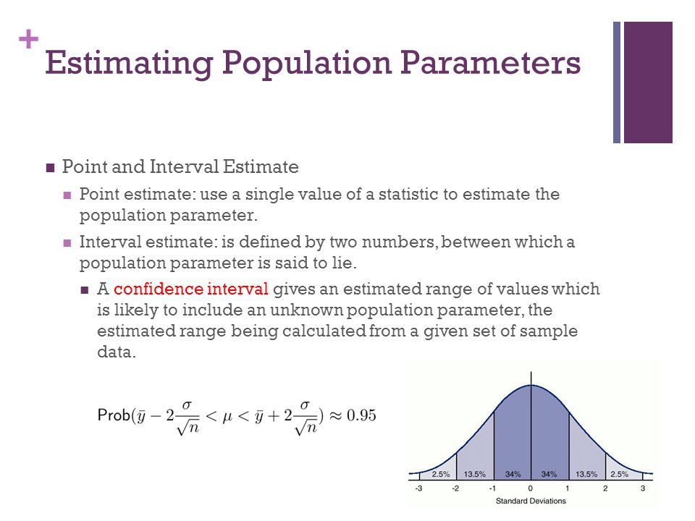

Slide 12
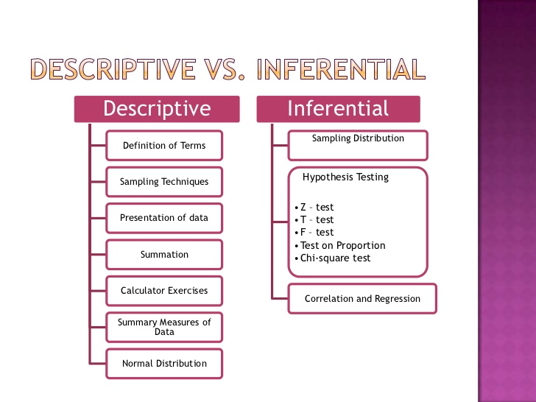

Slide 13
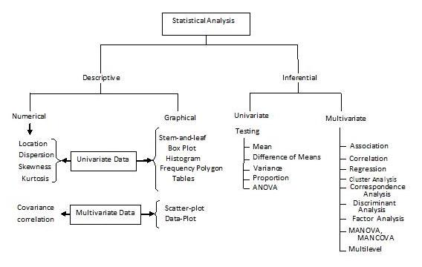

Slide 15
Inferential statistics are valuable when examination of each member of an entire population is not convenient or possible. For example, to measure the diameter of each nail that is manufactured in a mill is impractical. You can measure the diameters of a representative random sample of nails. You can use the information from the sample to make generalizations about the diameters of all of the nails.

Slide 16
Descriptive statistics provide a concise summary of data.
You can summarize data numerically or graphically.

Slide 17
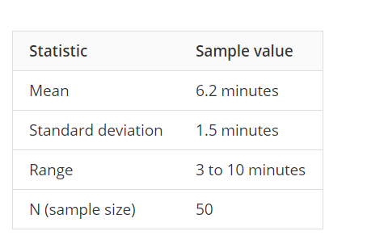
Descriptive

